Slide 1


Slide 2
GROUP 17
Demo 2
Software Engineering
14:332:452
Keeyan Haghshenas
Umer Qazi
Joe Gordon
Dunbar Birnie
Ludwig Randazzo
Colter Mooney
Bohdan Kryzh
Ashish Motyala

Slide 3
Meet The Team
Ducklabs Developments is dedicated to providing an educational, user friendly and optimal experience. Ducklab Developments contains a large number of talented and well rounded programmers. Boasting an eight member team we at the Ducklab Developments development have expertise in all major programming languages ranging from .NET app development languages to data analysis languages.

Slide 4
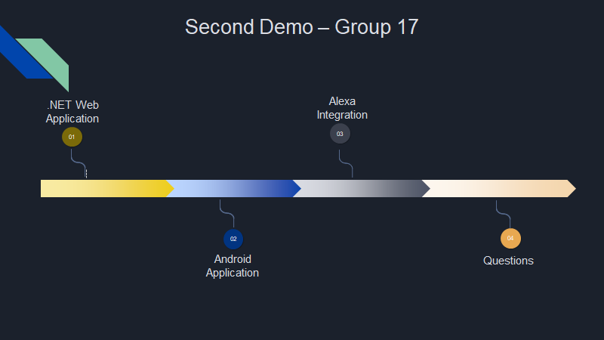

DuckLab Developments Is Proud To Present Our First Product

Slide 5
DuckLab Developments Is Proud To Present Our First Product

Slide 6
Ducklab Investments - What Is It?
Creates a fun and educational way for all experiment with stock trading and investing with zero real risk.
Provides Zero Risk Platform - To remove barriers of entry and allow all to practice investing despite monetary status
While also providing an entertaining competitive edge that not only educates but also excites

Slide 7
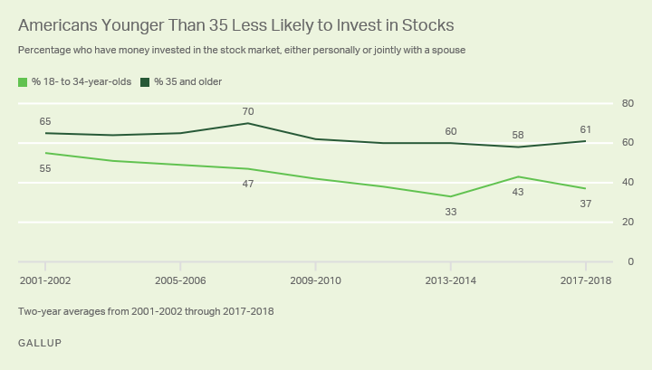
Why Play? Why is It Necessary?
Ducklab Investments Is An Educational Tool
With the number of companies rising everyday a firm understanding of the stock market is necessary for prosperity of wealth,financial longevity and retirement planning
Large decline in young investors since 2001.
It is clear that there is a stigma surrounding the stock market
Our product not only combats this, but also provides a fun game to play in your free time, that not only excites but educates!

Slide 8

Who is going to play? Who is it geared towards?
Ducklab Investments is for everyone!
Primarily we are focusing our market towards curious students and primary schooling, as tool to educate about the stock market
However, having a fantasy background we have managed a user friendly environment that is not too rudimentary nor too advanced for all generations

Slide 9


What Makes This Different?
Different Game modes to present to the User for various gameplay experiences
Android Application and Alexa integration to allow ease of access for the user
Hardware ticker to see your games and stock prices

Slide 10
.NET Overview and Functionality
System Functionality
Our App is able to connect to our SQL database.
Our App is able to call the IEX API to retrieve stock data and input into our SQL database.
Our app is able to update the SQL database with user input.
Our app’s code is now hosted on azure and you can use it by navigating to ducklabinvestments.azurewebsites.net
User Functionality:
Able to sign up and create a new account.
Able to login.
Able to create a Game.
Able to search all games with the game details.
Able to play and finish three different game modes
Able to Join Existing Game.
Able to buy/sell stocks for a game.
Able to search through all companies with their stock history.

Slide 11
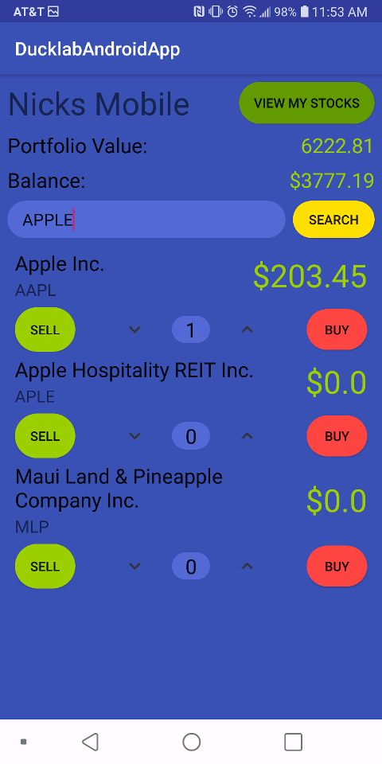
Android Application Functionality
App connects to the same Azure database which serves as the backend of our .NET app.
Android SQL Database connection managed with JDBC and the JTDS Driver.
Allows for streamlined connection to the main database to read and write our changes.

Slide 12
Alexa Integration
Created our own API from the .NET application to communicate to Alexa
Architecture: Your Speech → Alexa Skills Kit → AWS Lambda Hosted Program → Alexa Skills Kit → Alexa Speaks to You
Alexa Demo

Slide 13
